Slide 1
SOCIAL MEDIA ANALYSIS OF AFLAC
BUSINESS ANALYTICS CAPSTONE PROJECT

Slide 2
INTRODUCTION
High Influx of Data
Insurance Industry
Possibilities and challenges
Purpose of the project

Slide 3



DATA
TWITTER : 42,519 rows, 17 columns
GLASSDOOR: 12,020 rows, 21 columns
REDDIT: 700 rows, 2 columns

Slide 4
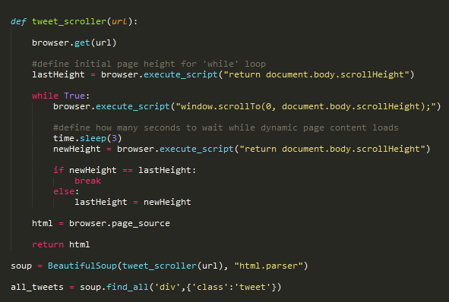
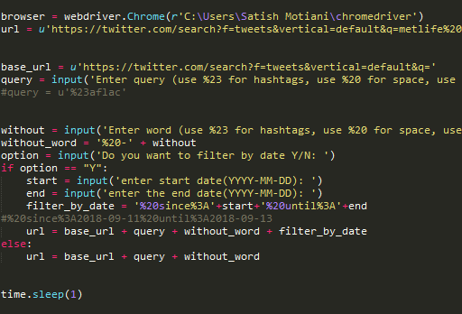
DATA COLLECTION

Slide 5
PREPROCESSING
Update location
Filter Agents/Remove Duplicates
Remove special character
Remove Stop words
Tokenize

Slide 6
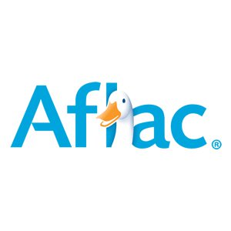
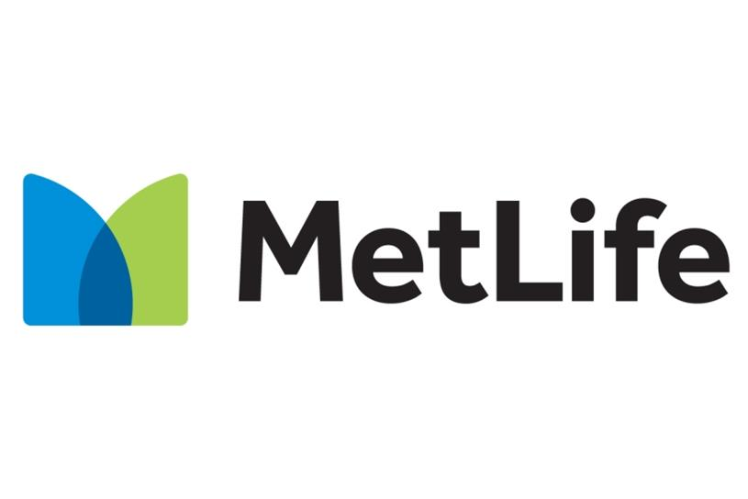
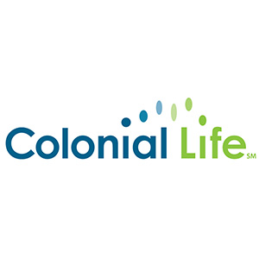
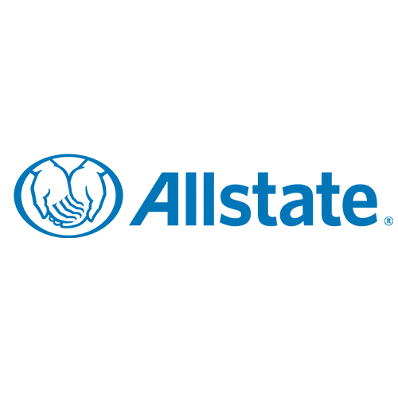
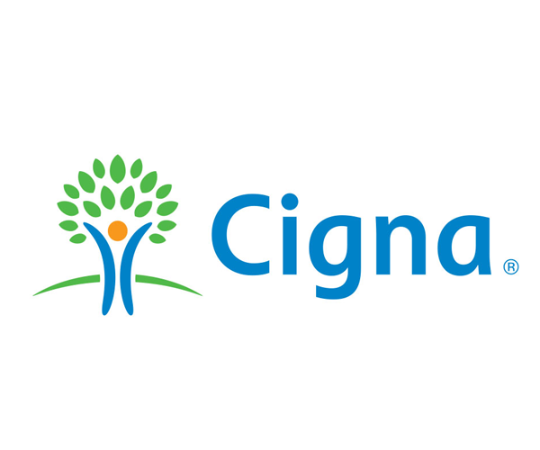
No. of Rows
AFLAC : 26,948
ALLSTATE : 4,797
CIGNA: 10,629
METLIFE: 18,756
COLONIAL LIFE: 1,306

Slide 7

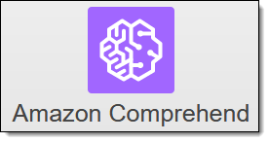

TOOLS USED

Slide 8
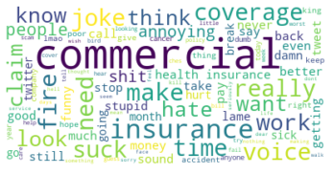
AFLAC’S WORD CLOUD

Slide 9
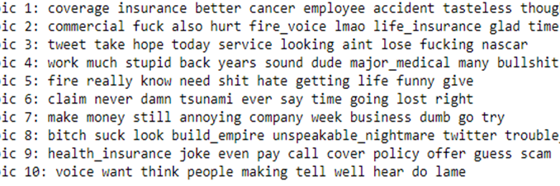
AFLAC’S TOPICS

Slide 10
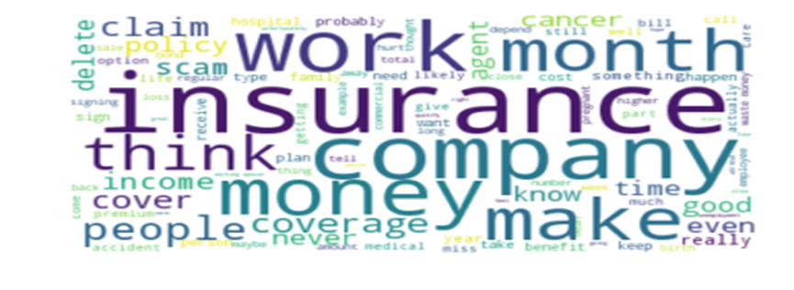
REDDIT’s WORD CLOUD

Slide 11
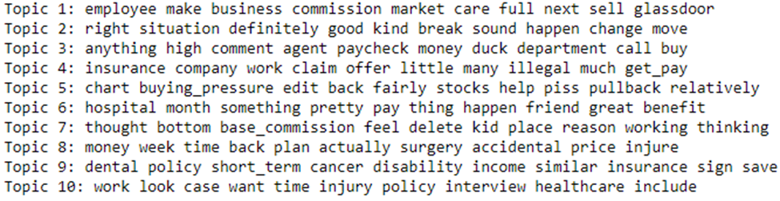
REDDIT’s TOPICS

Slide 12
CONCLUSION
Aflac can introduce a twitter handle to address customer grievances similar to All State Cares.
Customers are extremely positive about Duckprints and Aflac’s contribution towards cancer.
Aflac has better social media presence as compared to its competitors.
Aflac’s Company Benefits rating is less when compared to its competitors.
On Glassdoor and Reddit, the major concerns were about salary, commissions and challenges faced in cold-calling.

